Slide 1
CONTACT BOOK
-- SAACHI CHANDRASHEKHAR

Slide 2
Problem Statement
This is an excellent python project idea for beginners. Everyone uses a contact book to save contact details, including name, address, phone number, and even email address. This is a command-line project where you will design a contact book application that users can use to save and find contact details. The application should also allow users to update contact information, delete contacts, and list saved contacts. The SQLite database is the ideal platform for saving contacts.

Slide 3
Flowchart
The main menu contains 5 options to choose from.
1. CREATE NEW CONTACT

Slide 4
2. SEARCH DATA

Slide 5
3. UPDATE RECORD

Slide 6
4. DELETE RECORD
5. VIEW ALL RECORDS

Slide 7
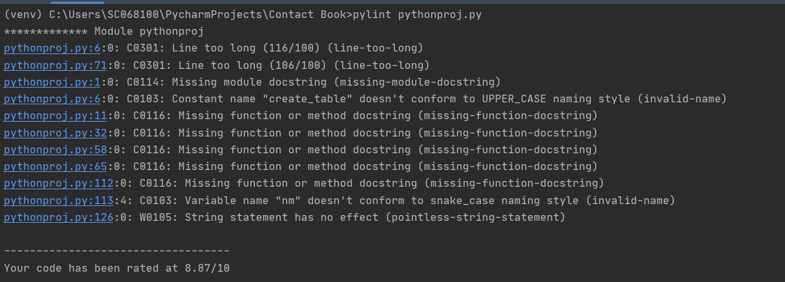
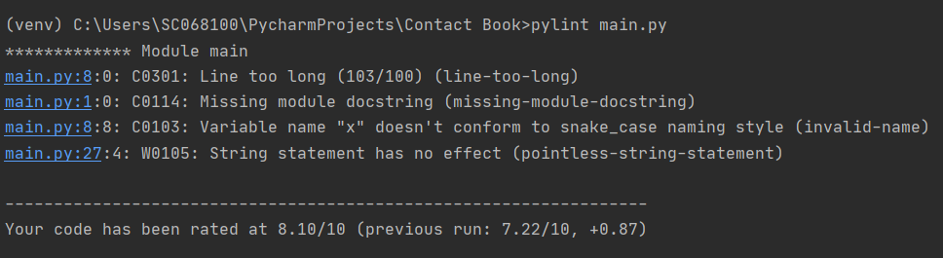
Tool - Pylint
PYLINT - Quality checker for the Python programming language.

Slide 8
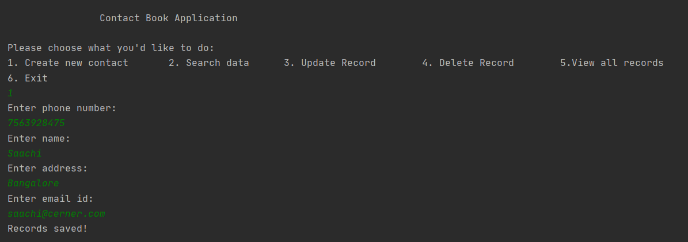
Output
1. Create new contact

Slide 9
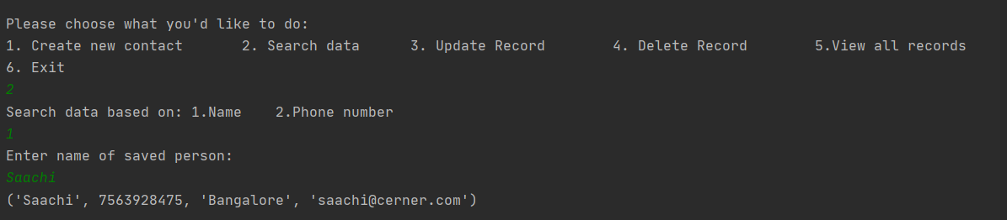
2. Search data

Slide 10
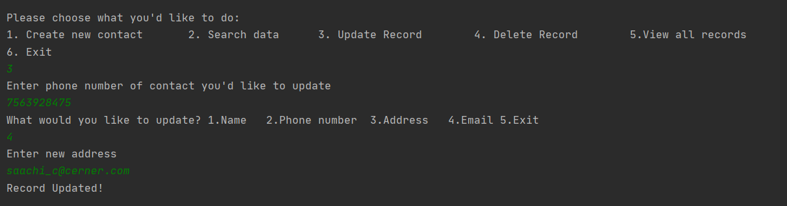
3. Update Record

Slide 11
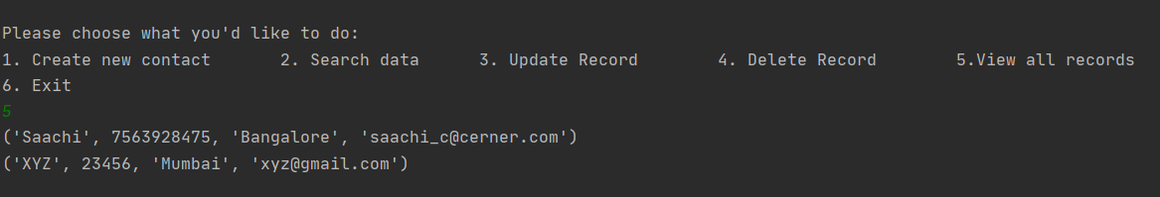
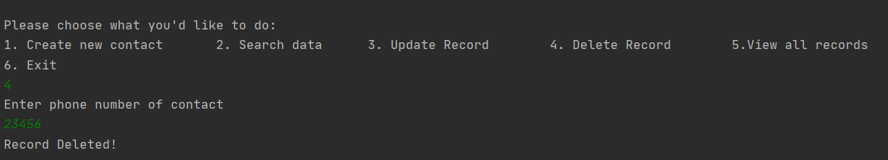
4. View all Records
5. Delete Record

Slide 12
THANK YOU

